Slide 1

Public’s Tax Preferences and Self-interest
Do people favor tax structures that favor them?
Do they change preferences when ‘nudged’ about the importance of government spending?
Keertana V. Chidambaram

Slide 2
Literature
Summary:
Respondents on average prefer tax structures assigning lower tax for their bracket.
Respondents consider total revenue generated when picking a tax structure.
Coexistence of high satisfaction with public services and displeasure with tax levied.
Demographic difference in tax preferences: (i) political affiliation, (ii) race, (iii) renter/homeowner etc.
Ballard-Rosa et al “The Structure of American Income Tax Policy Preferences”, Journal of Politics, (2017)
Citrin, “Do people want something for nothing: Public opinion on taxes and government spending”, National Tax Journal, (1979)
Beck et al, “Citizen views of taxes and services: a tale of three cities”, Social Science Quarterly (1987)

Slide 3
Motivation
On one hand people are self-interested, on the other, they care about public spending (superior government services and income redistribution)
So, how much are people willing to give up as tax in return for better government functioning and a more equitable society?
Is there is a demographic variation in this trend?

Slide 4
New contribution
Previous studies access the behavior based on loose economic models. This study would use an open source tax calculation (http://apps.ospc.org/taxbrain/) – much better estimation of tax policy change
No previous study accesses the change in behavior when presented with new knowledge
Plans for a more thorough study of demographical variation (e.g. inclusion of interaction terms, e.g. young republican vs. older democrat)

Slide 5
Tax Calculator: Overview
Open source tax calculator:
Python code: https://github.com/PSLmodels/Tax-Calculator
Webapp: http://apps.ospc.org/taxbrain/
Simulates USA federal income and payroll tax system
Based on 2 micro-datasets:
IRS-SOI Public Use File
Census Current Population Survey

Slide 6
Tax Calculator: Inputs and Outputs
Input parameters:
Maximum table earnings for social security (1 threshold)
Long term capital gains and qualified dividend tax rates (3 brackets)
Personal income tax rates (7 brackets)
S No. | Variable | Brackets | Default value | Survey range
1 | Maximum table earnings for Social Security |  | $127,200 | $0 - $1,000,000
2 | Personal income: non-AMT, non-pass-through | {$9,325, $18,650, $9,325, $13,350} | 10% | 0%-25%
3 |  | {$37,950, $75,900, $37,950, $50,800} | 15% | 0%-30%

Slide 7
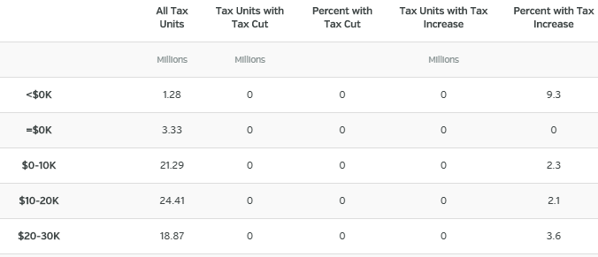
Tax Calculator: Inputs and Outputs
Output parameters:
% population affected in the income group
Average % change in after tax income
Average total tax change in group
Change in total government liabilities

Slide 8
Survey Design: Computation
Model iterations:
11 parameter, ~3-4 options each, ~1,000,000 possible solutions
Pre-computing or compute on demand?
Pre-computing approximate time:
1,000,000 iterations * 1 min / 200 clusters / 60 mins / 24 hours ~ 3.5 days
Advantages: less lookup time, less probability of glitches
Disadvantages: redundant calculations (~10,000 respondents vs. ~1,000,000 computations)

Slide 9
Survey Design: Computation
Computational tools:
Tax calculator python interface
Parallel processing
Database management

Slide 10
Answers
Measure of pro-tax behavior in the population
Observing behavior change with ‘nudge’
Which demographic is more likely to be pro-tax and which anti-tax?

